Slide 1
Assignment 2: Search and Optimization
TEAM MEMBER : CS22B034 , CS22B053

Slide 2
Environment
Frozen Lake :
This is a grid-world game where an agent tries to reach a goal without falling into holes. The surface is slippery, so the agent’s moves might not go as planned.
Used in: Branch & Bound, Iterative Deepening A*
Traveling Salesman Problem (TSP)
A salesman must visit all cities once and return to the starting point using the shortest path. It’s a hard problem with no quick solution.
Used in: Hill Climbing, Simulated Annealing

Slide 3
Heuristics Used
Environment: Frozen Lake
Branch & Bound Branch and Bound systematically explores all possible paths but prunes those that exceed the current best cost. It does not use any heuristic—decisions are purely based on actual path cost. Heuristic: None
Iterative Deepening A* Since Frozen Lake is a 2D grid with movement in four directions (up, down, left, right), a natural heuristic is the Manhattan Distance (sum of horizontal and vertical distances to the goal). Heuristic: Manhattan Distance

Slide 4
Heuristics Used
Environment: Traveling Salesman Problem (TSP)
Hill Climbing Tries to minimize the total path cost by swapping cities and picking the better solution each time. Heuristic: Total Path Distance
Simulated Annealing Similar to Hill Climbing but allows occasional moves to worse solutions to avoid local optima. The decision is based on total distance and a probability influenced by temperature. Heuristic: Total Path Distance + Randomness

Slide 5
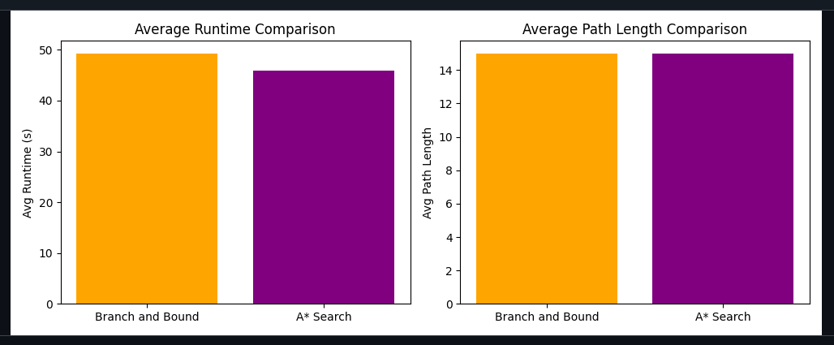
Time compression :

Slide 6
Observations
Alpha-Beta Pruning (K-Ply) was the fastest algorithm in chess — delivering optimal moves (c1f4) in just 0.88 seconds, making it ideal for real-time use.
Minimax (Full) took the longest time (199.17s) due to exhaustive search and no pruning — not practical for time-sensitive applications.
In Frozen Lake, Iterative Deepening A* performed efficiently using Manhattan Distance, while Branch & Bound required more time due to lack of heuristic guidance.
For TSP, Simulated Annealing handled local optima better than Hill Climbing by accepting worse paths occasionally — resulting in more consistent and flexible solutions.

